Slide 1

Chapter 9
Lifespan Development

Slide 2


The Marshmallow Experiment
Walter Mischel

Slide 3
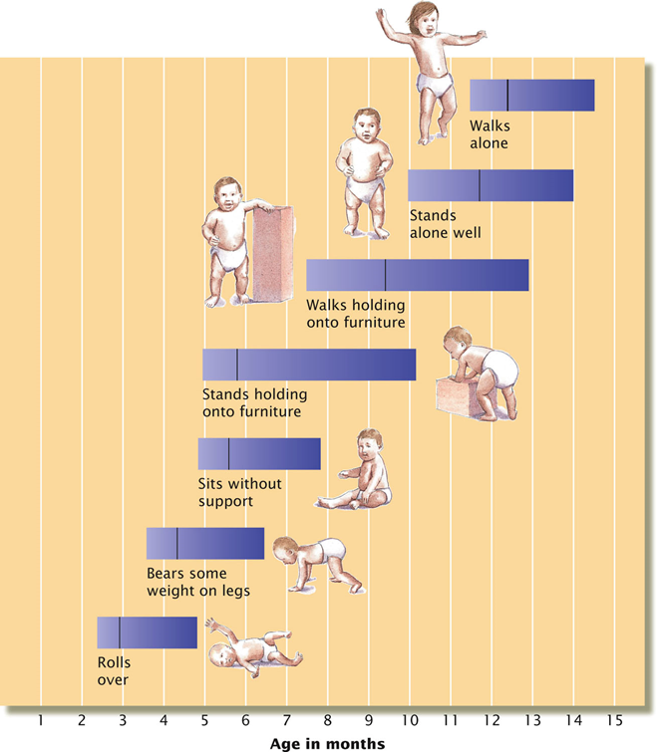
Lifespan development
Physical development
Cognitive development
Psychosocial development
The normative approach to development: determines norms of when most children reach specific developmental milestones in each of three domain

Slide 4
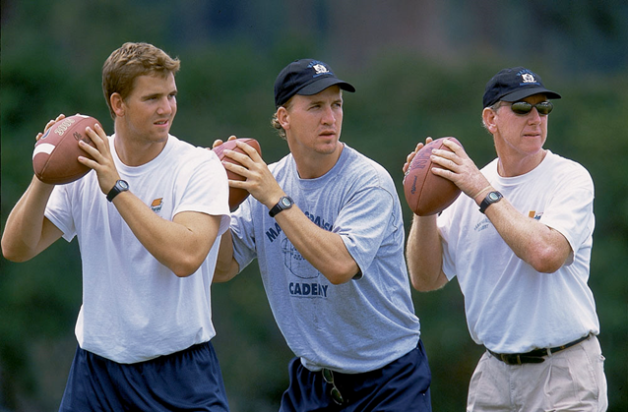
How do nature and nurture influence development?
Both operate to make each person unique
Heredity creates predispositions
Environment influences how they develop
Nature contributes strongly to some characteristics
Physical size
Appearance
More complex traits are influenced by environmental factors as well as genes
Intelligence
Personality

Slide 5
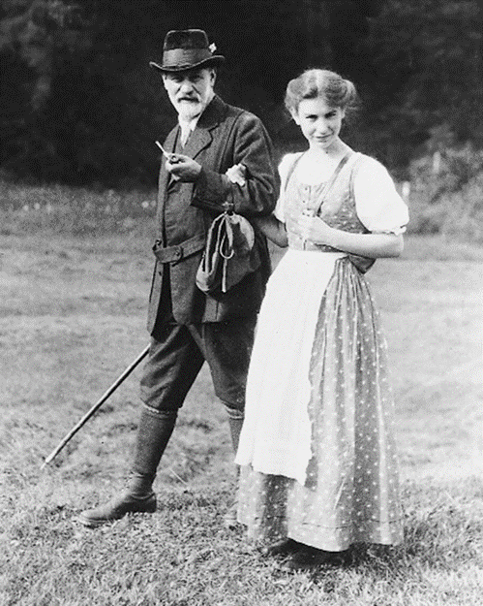
Psychosexual theory of development
Sigmund Freud
Stages of psychosexual development:
Oral Stage
Birth to age 2
Anal Stage
Ages 2 to 3
Phallic Stage
Ages 3-5
Boys: Oedipal complex
Girls: Electra complex
Latency Period
Age 5 to adolescence
Genital Stage

Slide 6
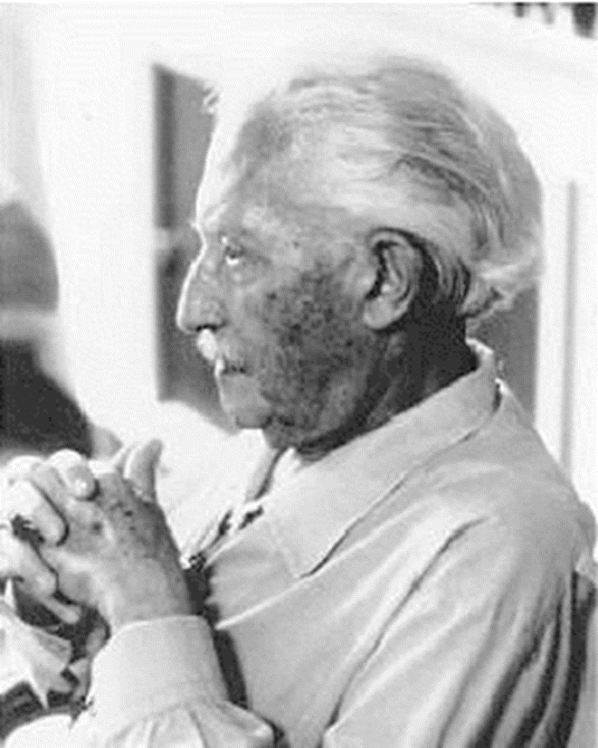

Psychosocial theory of development
Eric Erikson
Eight stages of development
Resolve a conflict at each stage.
Sense of competence and a healthy personality if conflicts are resolved.
Feeling of inadequacy if not.

Slide 7
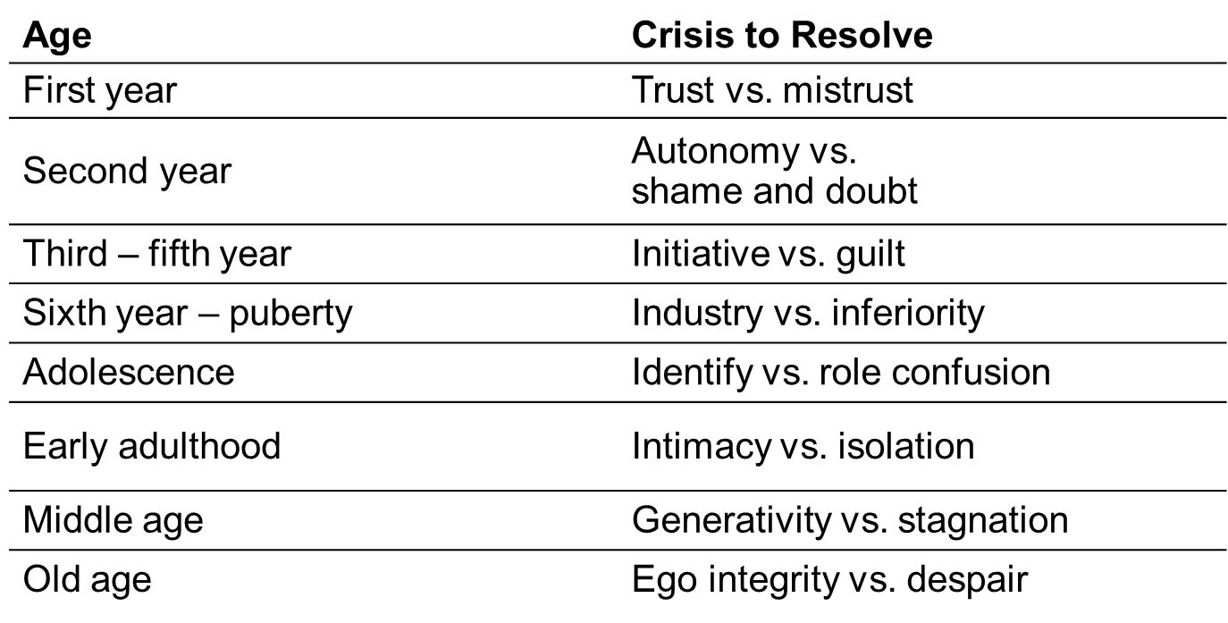
Psychosocial theory of development

Slide 8
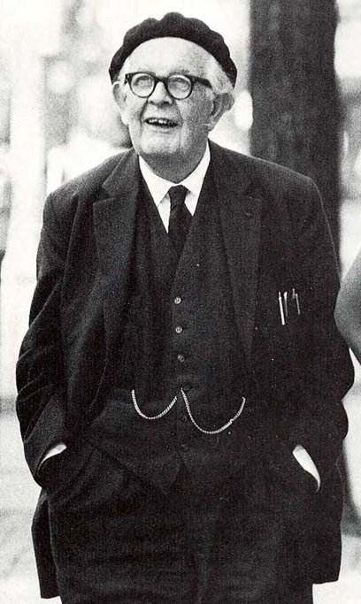
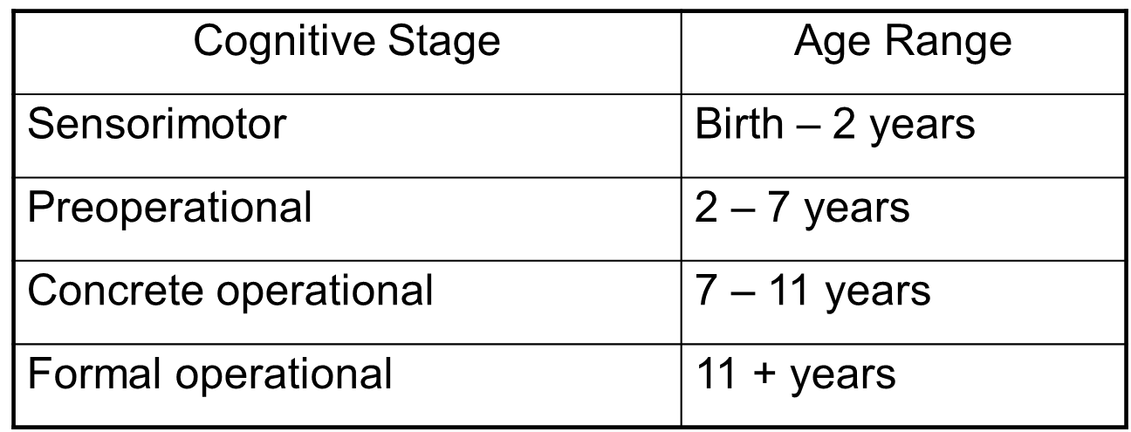
Piaget’s cognitive development theory
Jean Piaget
Cognitive development happens in stages
Qualitative changes in thinking from previous stages

Slide 9

Piaget’s Stages of Cognitive Development: The Sensorimotor Stage
Birth-2 years
Mental activity and schemas confined to sensory functions
Develops object permanence towards end of period

Slide 10
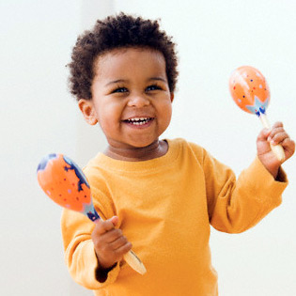
Piaget’s Preoperational Stage
2-4 years old
Begin to understand, create, and use symbols
4-7 years old
Begin to make intuitive guesses about the world
Cannot differentiate between imagination and reality
Inanimate objects are alive
Thinking is highly egocentric (Three-Mountain Task)
Lack conservation (Conservation Task)

Slide 11

Piaget’s Stages: Concrete Operations
Ability to conserve number and amount
Appearances no longer dominate thinking
Can use simple logic
Can perform simple mental operations
But only on concrete objects
Can reason only about what is, not what is possible

Slide 12

Piaget’s Stages: The Formal Operational Stage
Can think logically about abstract ideas
Can engage in hypothetical thinking
Can think logically and systematically about symbols and propositions
Questions social institutions
Thinks about world as it might be and ought to be

Slide 13

Beyond Formal Operational Thought
Many psychologists disagree with Piaget about formal operation stage being the highest level.
Postformal stage: decisions are made based on situations, logic is integrated with emotion
Postformal thinkers can draw on past experiences to help them solve new problems.

Slide 14

Theory of moral development
Lawrence Kohlberg investigated people’s judgments in moral dilemmas.

Slide 15
Theory of moral development
Preconventional reasoning: Stages 1 & 2
Moral judgments tend to be selfish
Conventional reasoning : Stages 3 & 4
Morality consists of following rules and conventions
Postconventional reasoning: Stages 5 & 6
Moral judgments based on personal standards or universal principles

Slide 16
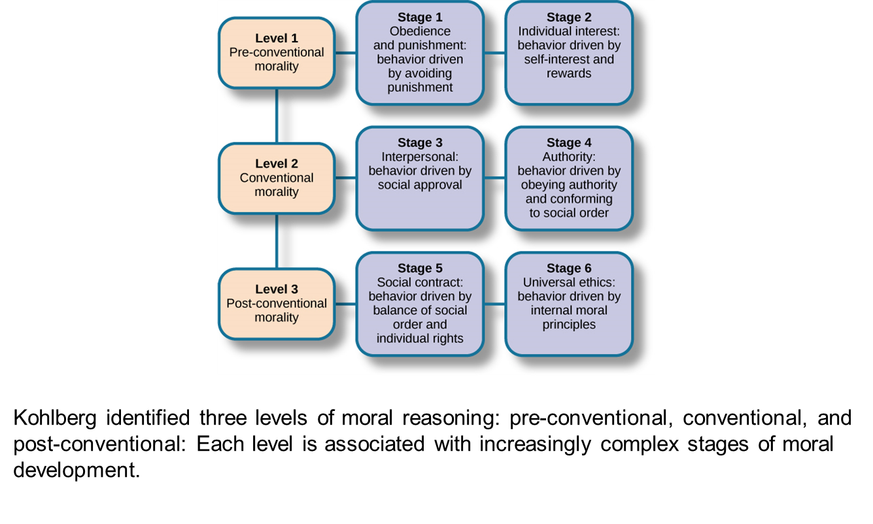

Slide 17
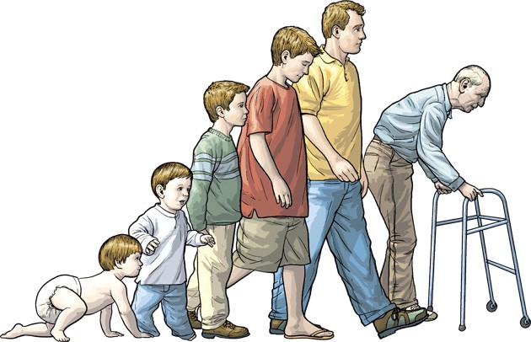
Stages of Development

Slide 18
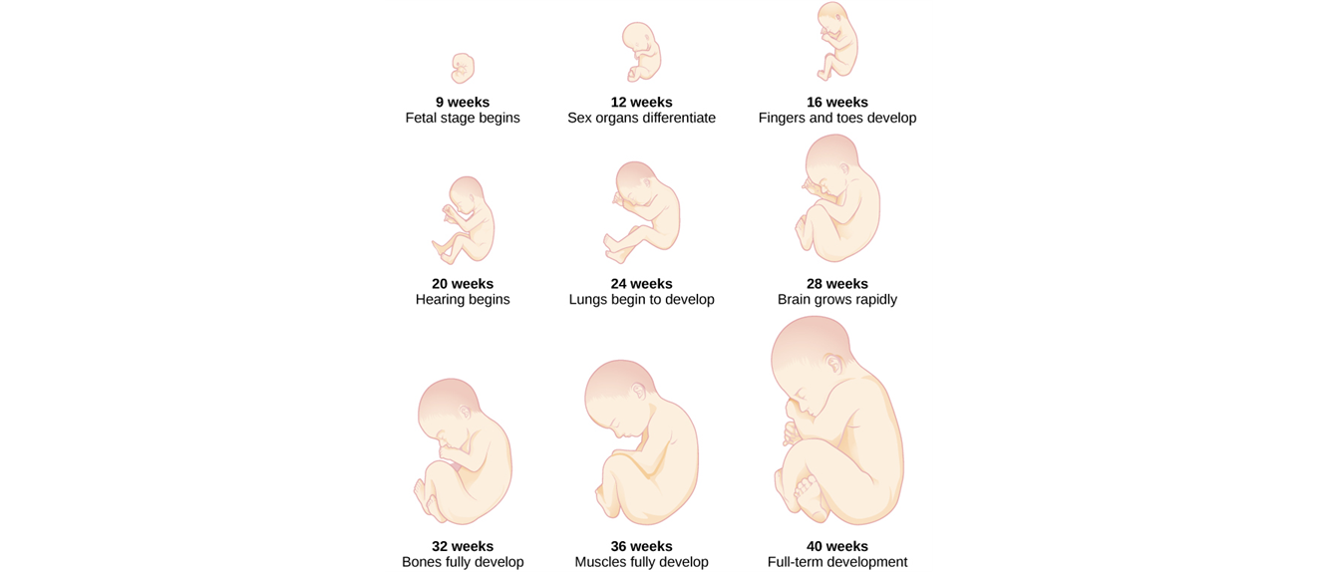
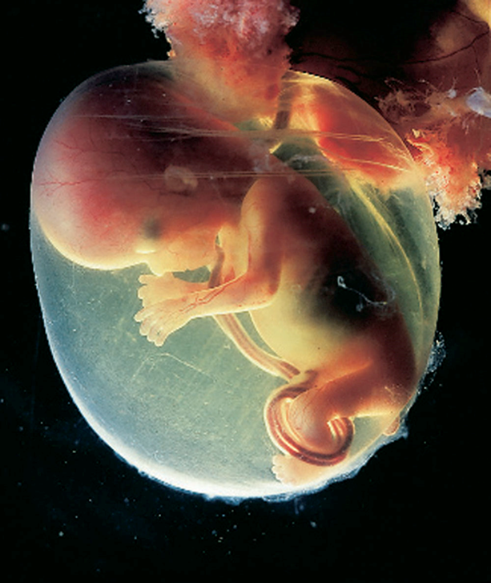
Prenatal development
Zygote (germinal stage)
Embryo (embryonic stage)
Fetus (fetal stage)

Slide 19


Prenatal influences
Role of the placenta
Critical periods
Examples of teratogens
Rubella (German measles)
Drugs such as cocaine
Alcohol
Smoking

Slide 20
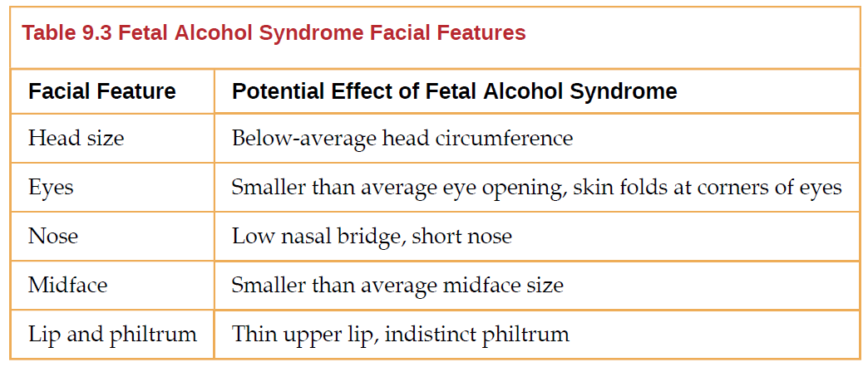
Prenatal influences

Slide 21
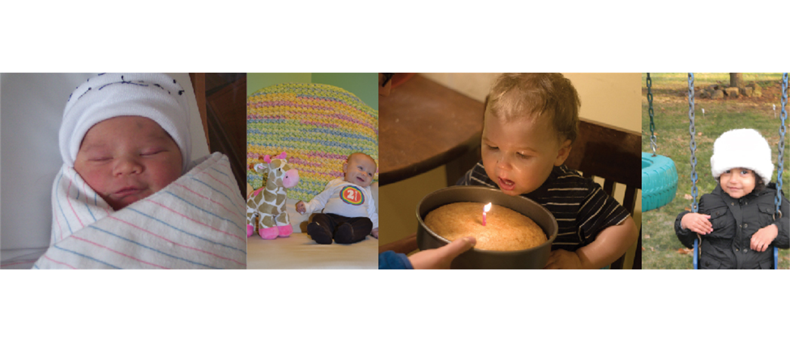
Infancy through childhood

Slide 22


Newborn’s Vision
About 20/300
What you’d see
What a newborn sees
Prefer faces and face-like objects

Slide 23

Newborn’s Sense of Hearing
At 2 or 3 days of age
Can hear soft voices
Notice the difference between musical tones
Turn toward sounds
Particularly attuned to the sounds of speech
By 4 months of age
Can tell differences among almost all of the phonetic contrasts in adult languages
Prefer rising tones spoken by women or children
Like “baby talk”—high-pitched, exaggerated, expressive speech

Slide 24
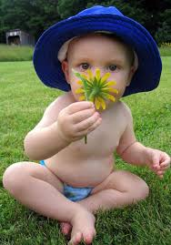
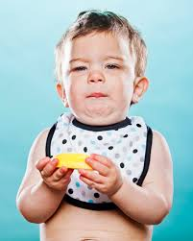
Newborn’s Senses of Smell and Taste
Smell
Like the smell of flowers
Like the odor of their own mother’s breast and breast milk
Dislike the smell of ammonia (in wet diapers)
Taste
Like the taste of sweet drinks
Develop preferences for the food flavors their mothers eat

Slide 25
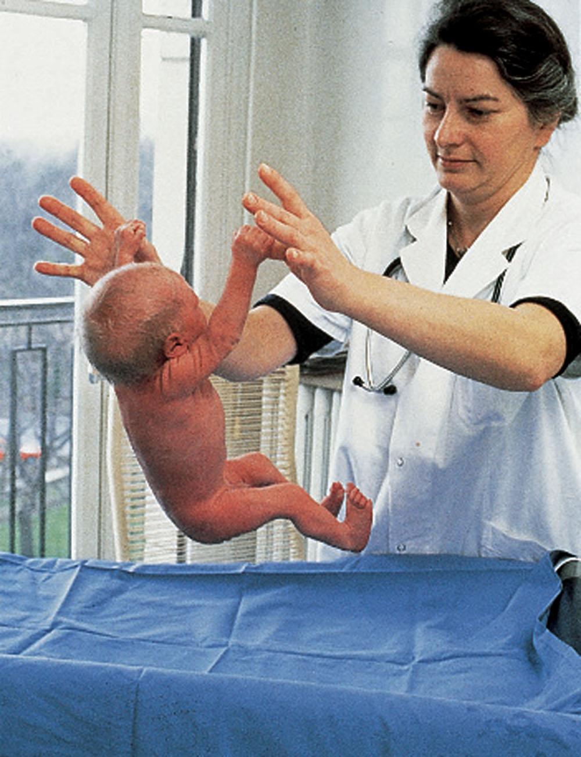
Reflexes of the Newborn
Involuntary, unlearned motor behaviors
Examples of observed reflexes:
Grasping
Rooting
Sucking
Most disappear around 4-5 months

Slide 26

Physical development
We are born with all the brain cells that we will ever use.
The size of brain increases rapidly
Early childhood: the frontal lobe grows rapidly
Elementary school years: all four lobes grow in size.

Slide 27
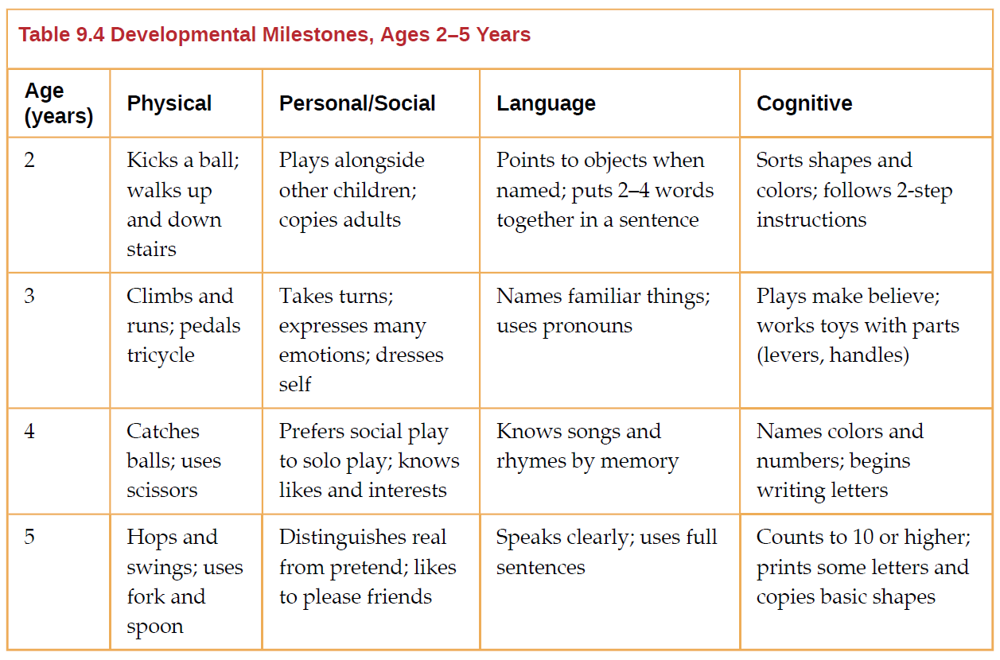
Age 2-5 development milestones

Slide 28
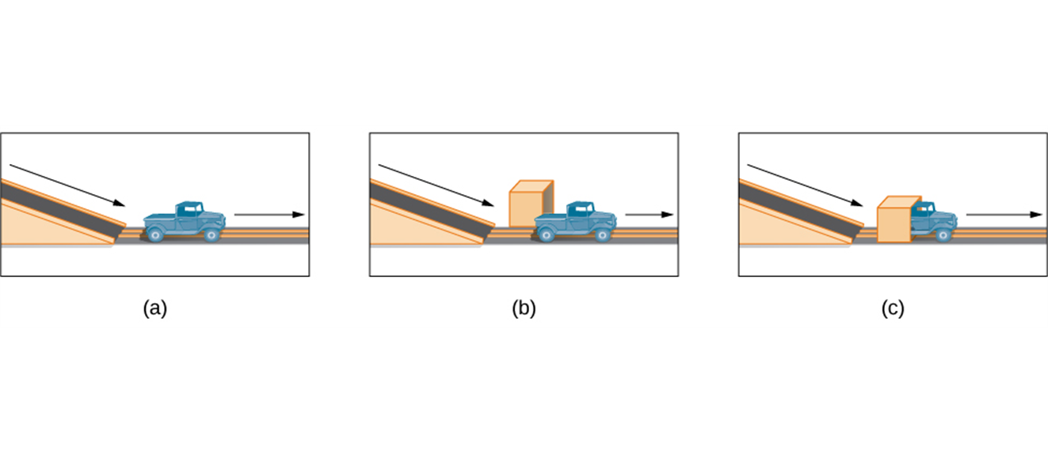
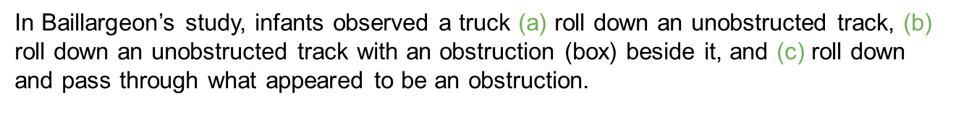
Cognitive development
Even very young children understand objects long before they have experience with the object.
Preschool-age children:
Can count, name colors, etc.
Make decisions on their own
Can think symbolically
3-5 years old:
Theory-of-mind: children realize that people have thoughts, feelings and beliefs that are different from their own.

Slide 29
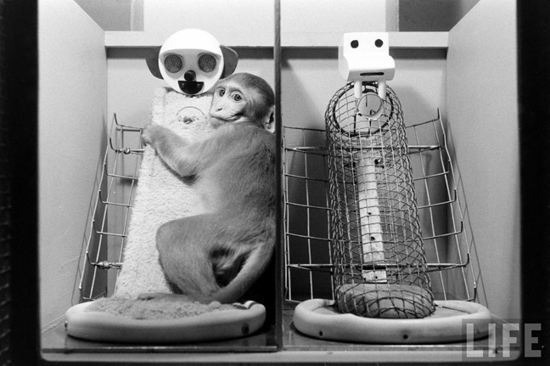
Attachment
A deep, affectionate, close, and enduring relationship to important figures
John Bowlby’s attachment theory
Nature of attachment can have long-term and far-reaching effects
Harlow’s Motherless Monkey: attachment depends on contact comfort

Slide 30
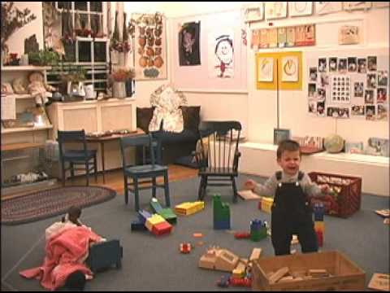
Attachment: Mary Ainsworth and the Strange Situation
Technique to evaluate attachment styles
Secure attachment
Insecure attachment
Avoidant
Resistant
Disorganized

